Slide 1


Unit-1 Introduction to Accounting
Fundamentals of Accounting (FOA)
DU #2301MN523
Prof. Javed S. Nathani
javed.nathani@darshan.ac.in
91066 34874

Slide 2

Looping
Topics
Technical Terms in Accounting
What is Accounting?
Users of Accounting Information
Process of Accounting
Classification of Accounts and its Golden Rules
Characteristics of Accounting
Objectives of Accounting
Branches of Accounting
Accounting Concepts
Accounting Conventions
Classification of Accounts - Practice

Slide 3

Technical Terms Used in Accounting

Slide 4
Accounting Terminologies
Accounting
A systematic way of recording and reporting financial transactions for a business or an organization.
Entry
Entry means record of a transaction in the books of account. When a transaction is recorded in journal or other subsidiary books, it is said that an entry is made.
Transaction
A transaction is an exchange of goods, services and cash, between persons. It is an event and it gives rise to an entry to be made in the books of account.

Slide 5
Accounting Terminologies
Voucher
It is a document supporting a business transaction, which has been entered in the books of account.
e.g., if a customer has made payment to us, we issue a receipt to him, this receipt is a Voucher.
Debit
It is a left-hand side of an account. ‘To Debit’ means to write on the debit side of an account.
Credit
It is a right-hand side of an account. ‘To Credit’ means to write on the credit side of an account.

Slide 6
Accounting Terminologies
Journal
It is a book of original entry in double entry book-keeping. It is a book in which a transaction is entered, immediately when it takes place.
The entry made in this book is called ‘Journal Entry’.
Subsidiary Books
In a business where a large number of transactions take place daily, all transactions cannot be entered in one book called journal.
It will involve lot of time and labor. So, separate journals are kept for particular types of transactions, which are called subsidiary books.
E.g., for recording all credit transactions related to purchase of goods, a purchase book is kept.

Slide 7
Accounting Terminologies
Account
An Account is a summarized record of the transactions at one place relating to one person, one kind of property or one class of expense or income.
Each account is divided into two parts. The left-hand side is called a debit side and a right-hand side is called a credit side.
Ledger
It is a main book of account.
It is a book in which all accounts relating to persons, properties, incomes and expenses are prepared.

Slide 8
Accounting Terminologies
Posting and To Post
To post is an act of transferring an entry made in the book of original entry into ledger.
The process of transferring such entry is called Posting.
Balance
The difference between the totals of debit side and credit side of an account opened in a ledger for a specified period is called ‘Balance’.
The balance can be either a debit balance or a credit balance.

Slide 9
Accounting Terminologies
Goods
The word ‘Goods’ is used for those articles in which the business deals.
In other words, goods are those things which are bought by a businessman for resale to make profit.
Stock
It is a balance of goods lying unsold with business on any day.
The balance of goods on the last day of accounting year is known as ‘closing stock’ while balance of goods on the opening day of the year is known as ‘opening stock’.
Closing stock of one year becomes the opening stock of the next year.

Slide 10
Accounting Terminologies
Debtor
A debtor is a person who owes debt to business.
If goods are sold to a person on credit, or if we have rendered services to a person for which he has not made payment, or if we have lent money to a person, such person is called a ‘Debtor’.
Creditor
A creditor is a person to whom debt is owed by business.
He is a person, to whom we have to pay money because we purchased goods from him on credit or he gave us services or we have borrowed money from him.
It is a liability or debt of business to be paid in future.

Slide 11
Accounting Terminologies
Liabilities
They are debts which a business owes to others.
They are amounts payable by business.
Such liabilities are creditors, bank overdraft, bills payable, etc.
Assets
Assets are all those things or rights which are owned by the business and have monetary value.
They are properties which helps to run the business.
E.g., cash, machinery, stock, debtors, etc.

Slide 12
Accounting Terminologies
Fixed Assets
Fixed assets are those assets which are not purchased for resale, helps in running the business and whose benefit is available for a long time.
E.g., building, machinery, furniture, etc.
Current Assets
Current assets are those assets which are constantly converted into cash or other assets and whose value goes on changing every day.
E.g., stock, debtors, cash, etc.

Slide 13
Accounting Terminologies
Tangible Assets
Tangible assets are those assets which have physical existence.
I.e., which can be seen and touched.
E.g., machinery, vehicles, stock, etc.
Intangible Assets
Intangible assets have no physical existence.
I.e., they cannot be seen or touched but they have monetary value.
E.g., goodwill, patents, copyrights, etc.

Slide 14
Accounting Terminologies
Capital
The amount invested by the proprietor in a business is called capital.
A businessman brings capital when he starts business and he may also bring additional capital whenever more money is needed in business.
Drawings
It is the value of cash or goods or any other asset withdrawn from business by a proprietor for his personal or domestic use.
This personal account of the proprietor is called ‘Drawing Account’.

Slide 15
Accounting Terminologies
Solvent
A person is said to be solvent when his assets are more than his liabilities.
He is able to pay his debts to the third parties in full.
Insolvent
If a person’s liabilities are more than his assets, he is called ‘insolvent’.
He is not able to pay his debts in full.
Expenses
It is the money spent in conducting the business.
It is paid for some services rendered by others.

Slide 16
Accounting Terminologies
Revenue
Revenue is gross money receipts from sale of products and services.
E.g., when goods costing Rs.1,000 are sold for Rs.1,500, then revenue is Rs.1,500.
Income
Income is net earnings from sale of products or services or on, any other account.
E.g., when goods of Rs.1,000 are sold for Rs.1,500, the difference of Rs.500 is the income.
Bad debts
A person who owes debts to the business is a debtor. If, out of the amount receivable, some amount is not received, then it is a loss of business.
Such loss is known as Bad debts.

Slide 17
Accounting Terminologies
Discount
If the business man agrees to receive some amount less than the printed price or the amount shown in the invoice, the difference is called discount.
Trade Discount
When a producer or a wholesaler allows some deduction on the catalogue price to the retailer, it is called trade discount.
T.D. is not recorded in the books.
Cash Discount
Cash discount is an allowance made by the receiver of cash to the payer for making prompt payment.
C.D. is recorded in the books of accounts.

Slide 18
Accounting Terminologies
Allowance
At the time of settlement of debt, some amount is allowed by the receiver to the payer, which is known as allowance. (E.g., Round-off Value)
Profit
During a specified period, if the total income is more than the expenses, the difference is called ‘Profit’.
Loss
If during a specified period, the expenses are more than the income, then the difference is called ‘Loss’.

Slide 19
Accounting Terminologies
Loan
Any amount borrowed or lent is called Loan.
Bills receivable
When a debtor put his signature, on a document drawn by his creditor asking him to pay money after a specified time, the document is called bill receivable for the creditor.
Bills payable
The document which is written by a creditor and on which the debtor puts his signature and accepts to pay the amount mentioned therein within a specified time period, it is a bill payable for the debtor.

Slide 20
Accounting Terminologies
Gross Profit or Gross Loss
When the sales are more than the purchase price of goods plus purchase expenses, then the difference is called Gross Profit.
Conversely, if the sale proceeds are less than the purchase price plus expenses, the difference is the Gross Loss.
GP or GL is the result of Trading Account.
Net Profit or Net Loss
Net Profit is a surplus left after deducting all expenses from gross profit and adding other incomes to it.
If, however, the expenses exceed the gross profit and other incomes, then the difference is the Net Loss.
NP or NL is the result of Profit & Loss Account.

Slide 21
Accounting Terminologies
Trial balance
A statement is prepared at the end of the year, in which balances of all the accounts of the ledger are shown to verify the arithmetical accuracy of accounts.
This statement is called a trial balance.
Balance Sheet
It is a statement prepared at the end of the year to know the financial position of the business.

Slide 22
Accounting Terminologies
Annual Accounts or Final accounts
At the end of the year, some statements are prepared to show the profit or loss of the business and also to know the financial position of business.
These statements are called annual accounts or final accounts.
They include Trading account to show the gross profit or gross loss, Profit and Loss account to show the net profit or net loss and Balance sheet showing assets and liabilities of business.

Slide 23
What is Accounting?

Slide 24
What is Accounting?
Accounting is often called language of business.
Accounting is a common language used to communicate financial information from one person to another.
Accounting is a social science which has its concepts and principles which are used in applying the accounting cycle to achieve accounting functions and objectives.

Slide 25

Definition of Accounting
According to American Institute of Certified Public Accountants (AICPA),
“Accounting is an art of recording, classifying and summarizing in a significant manner and in terms of money, transactions and events, which are in part at least, of financial character and interpreting the reasons thereof. ”

Slide 26
Users of Accounting Information

Slide 27
Users of Accounting Information
Users
Internal Users
Owners
Management
Employees
External Users
Investors
Lenders
Suppliers and other trade creditors
Customers
Governments and their agencies
Public

Slide 28
Process of Accounting

Slide 29
Process/Cycle of Accounting
1.
Identifying the transaction
2.
Recording in Journal
3.
Posting in ledger
4.
Preparing Trial balance
6.
Financial Statements
5.
Adjusting entries
7.
Closing the books
Process of Accounting

Slide 30
Process of Accounting
Identifying financial transactions and events
Accounting records only those transactions and events which are of financial nature.
So, first of all, such transactions and events are identified.
Measuring the transactions
Accounting measures the transactions and events in terms of money which are considered as a common unit.
Recording of transactions
Accounting involves recording the financial transactions in appropriate book of accounts such as Journal or Subsidiary Books.

Slide 31
Process of Accounting
Classifying the transactions
Transactions recorded in the books of original entry – Journal or Subsidiary books are classified and grouped according to their nature and posted in separate accounts known as ‘Ledger Accounts’.
Summarising the transactions
It involves presenting the classified data in a manner and in the form of statements, which are understandable by the users.
It includes Trial balance, Trading Account, Profit and Loss Account and Balance Sheet.

Slide 32
Process of Accounting
Analyzing and interpreting financial data
Results of the business are analyzed and interpreted so that users of financial statements can make a meaningful and sound judgment.
Financial data is analyzed through Common size statement, Comparative financial statement, Trend Analysis, Ratio analysis, etc.
Communicating the financial data or reports to the users
Communicating the financial data to the users on time is the final step of accounting, so that they can make appropriate decisions.

Slide 33
Types of Transactions

Slide 34
Types of Transactions
Types
Of
Transactions
Economic
Transactions
Cash Transactions
Credit Transactions
Non-economic
Transactions

Slide 35
Types of Transactions
Economic Transactions
Those transactions in which money is exchanged, or such things or services are exchanged which can be measured in terms of money are called economic transactions.
E.g., Goods purchased from Abhishek for Rs. 50,000.
Non-economic Transactions
Those transactions in which money is not exchanged nor there is an exchange of such things and which cannot be measured in terms of money are called non-economic transactions.
E.g., Invitation to a friend for dinner.
E.g., Order received from Mr. A for goods of Rs. 10,000.

Slide 36
Types of Economic Transactions
Cash Transactions
A transaction in which there is a receipt or payment of cash is a cash transaction.
Cash balance is affected by such a transaction.
E.g., Goods sold for Rs. 50,000.
E.g., Goods purchased from Amit for Rs. 10,000. Amount paid by cheque.
Credit Transactions
In credit transaction, there is no receipt or payment of cash taking place immediately, but it is postponed to some future date.
It is a transaction in which no cash is exchanged.
E.g., Goods sold to Rahul for Rs. 10,000.

Slide 37
Classification of Accounts

Slide 38
What is an Account?
An account is a summary of all business transactions, relating to one person or item.
It is a two-sided statement, which records a group of similar transactions relating to one person, one kind of property or one class of expenses or incomes.
It is divided into two parts.
Left hand side is known as “Debit” side.
Right hand side is known as “Credit” side.

Slide 39
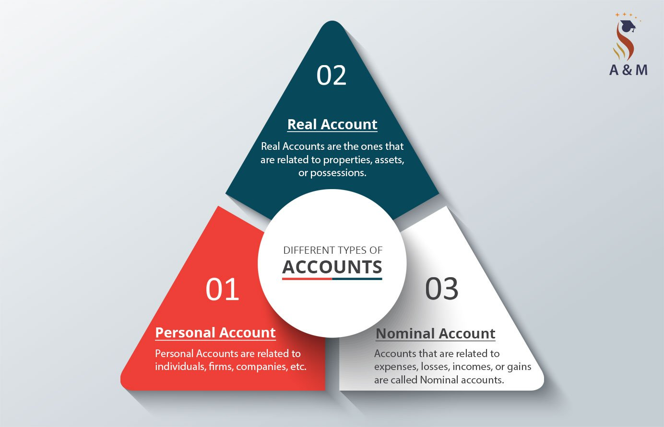
Types of Accounts
Personal Account
Real Account
Nominal Account
39

Slide 40
Classification of Accounts
Classification of Accounts
Personal વ્યક્તિ
Individuals, firms, companies, associations, co-operative society, etc.
Ram’s A/c,
RMC A/c,
LIC A/c,
BOI A/c
Impersonal બિન-વ્યક્તિ
Real માલ-મિલકત
Belongings to enterprise
Building A/c,
Machine A/c,
Cash A/c,
Stock A/c
Nominal ઊપજ-ખર્ચ
Incomes and expenses
Rent A/c,
Salary A/c,
Commission received/paid A/c

Slide 41
Personal Account
These accounts are related to persons.
These persons may be natural persons like Raj’s account, Rajesh’s account, Ramesh’s account, Suresh’s account, etc.
These persons can also be artificial persons like partnership firms, companies, bodies corporate, an association of persons, etc.
E.g., Rajesh and Suresh trading Co., Charitable trusts, XYZ Bank Ltd, ABC company Ltd, etc.

Slide 42
Real Account
The accounts relating to goods and other property are known as Real Accounts.
They are further classified as Tangible real account and Intangible real accounts.
Tangible Real Accounts: These include assets that have a physical existence and can be touched.
E.g., Building A/c, cash A/c, stationery A/c, inventory A/c, etc.
Intangible Real Accounts: These assets do not have any physical existence and cannot be touched. However, these can be measured in terms of money and have value.
E.g., Goodwill, Patent, Copyright, Trademark, etc.

Slide 43
Nominal Account
These accounts are related to income or gains and expenses or losses.
E.g., Rent A/c, commission received A/c, salary A/c, wages A/c, conveyance A/c, etc.

Slide 44
Rules of Debit and Credit

Slide 45
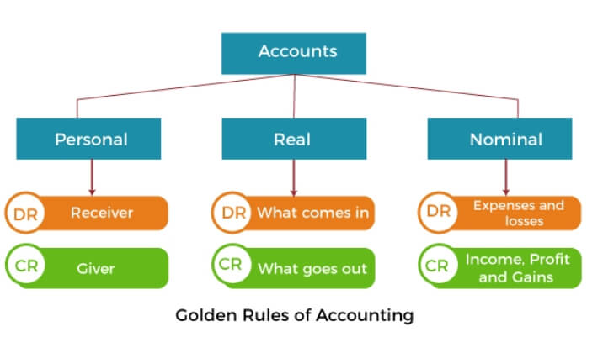
Rules of Debit and Credit

Slide 46
Three Golden Rules of Accounts
Accounts
Personal
વ્યક્તિ
“Debit the receiver,
Credit the giver”
લાભ લેનાર ખાતે ઉધાર, લાભ આપનાર ખાતે જમા
Real માલ-મિલકત
“Debit what comes in,
Credit what goes out”
મિલકત આવે તે ઉધાર, જાય તે જમા
Nominal ઊપજ–ખર્ચ
“Debit the expenses and losses,
Credit the income and gains”
ખર્ચ કે નુકશાન ખાતે ઉધાર, ઊપજ કે આવક ખાતે જમા

Slide 47
Rules for Personal Account
The account of the person who receives the benefit is debited and the account of the person who gives the benefit is Credited.
“DEBIT THE RECEIVER AND CREDIT THE GIVER”
E.g., Paid Rs. 500 to Vipul.
Here, Vipul is the receiver, so his account will be debited.

Slide 48
Rules for Real Account
When an asset comes into the business, the asset account is debited, because the asset gets the benefit.
Similarly, when an asset goes out of the business, the asset account is credited because it gives the benefit.
“DEBIT WHAT COMES IN AND CREDIT WHAT GOES OUT”
E.g., Sold goods to Mr. A for Rs. 1,000.
Here, goods are going out from the business, so Sale of goods account will be credited.

Slide 49
Rules for Nominal Account
When expenses or losses are incurred, their accounts must be debited.
Whenever, the incomes are received, the income account must be credited.
“DEBIT EXPENSES AND LOSSES AND CREDIT INCOMES AND GAINS”
E.g., Paid salaries Rs. 1,000.
Here, salary is an expense, so Salaries account will be debited.

Slide 50
Steps for Debiting or Crediting An Account
Check, whether it can be recorded in the books (Type of transaction)
Determine which accounts are getting affected
Determine the types of accounts
Apply the rules of Debit and Credit

Slide 51
Characteristics of Accounting

Slide 52
Characteristics of Accounting
Reliability (વિશ્વસનીયતા/ભરોસાપાત્રતા)
The reliability of accounting statistics is set by way of the correspondence between what the facts convey about the transactions or occasions that have occurred, measured, and displayed.
A piece of dependable information should be free from error and bias and faithfully represents what it’s meant to represent.
To make certain reliability, the facts disclosed should be credible and verifiable by way of unbiased events.

Slide 53
Characteristics of Accounting
Relevance (સુસંગતતા)
To be relevant, facts have to be accessible in time, ought to help in prediction and feedback, and ought to affect the selections of customers with the aid of:
assisting them to shape prediction about the results of past, current, or future events
confirming or correcting their previous evaluations.

Slide 54
Characteristics of Accounting
Understandability (સમજી શકાય તેવું)
Understandability is the capability of the decision-makers to interpret accounting information in an identical experience as it is organized and conveyed to them.
The qualities that distinguish between the right and awful conversation during a message are integral to the understandability of the message.
A message is said to be successfully communicated when it is interpreted through the receiver of the message in the equal experience in which the sender has sent.
Accountants should present the same facts in the most intelligible manner without sacrificing relevance and reliability.

Slide 55
Characteristics of Accounting
Comparability
It is not ample that the economic data is applicable and dependable at a singular time, during a specific circumstance, or for a singular reporting entity.
But it’s equally necessary that the purchasers of the regularly occurring motive economic reports can evaluate a variety of things of an entity over a definite time duration and with different entities.
To be comparable, accounting reviews need to belong to a standard duration and use a frequent unit of size and structure of reporting.

Slide 56
Objectives of Accounting

Slide 57
Objectives of Accounting
To maintain a systematic record of business transactions
To ascertain profit and loss
To determine the financial position
To provide information to various users
To assist the management

Slide 58
Advantages and Disadvantages of Accounting

Slide 59
Advantages of Accounting
A complete and systematic record
Valuation of the enterprise
Evidence in court
In accordance with the law
Inter-company or intra-company comparison
Facilitates auditing
Facilitates financial analysis
Effective management

Slide 60
Disadvantages of Accounting
Does not guarantee accuracy
Accounting ignores the qualitative element
Accounts can be manipulated
Costly for a small business
Business privacy
Ignores the concept of time value of money
Accounting policies differ from one business unit to another

Slide 61
Branches of Accounting

Slide 62
Branches of Accounting
Stewardship Accounting
Financial Accounting
Cost Accounting
Management Accounting
Social Responsibility Accounting
Human Resource Accounting
Environmental Accounting
Current cost Accounting

Slide 63

Stewardship Accounting
The Steward is the manager, who is entirely responsible for the estate that owned by the owner.
The owner use to visit once in a year or two and would verify the financial transactions of his properties managed by the manager.

Slide 64

Financial Accounting
Financial accounting is the original form of accounting.
It is primarily concerned with record-keeping of financial transactions directed towards preparation of final accounts / statements.
Its main purposes are :
Recording the transactions
Preparation of final accounts
Reporting to the users of accounting information

Slide 65

Cost Accounting
Cost accounting is that part of accounting which deals with the accumulation, classification, recording, allocation, summarization and reporting of current and future costs.
It is the systematic procedure for determining the cost per unit of the product or a service.

Slide 66
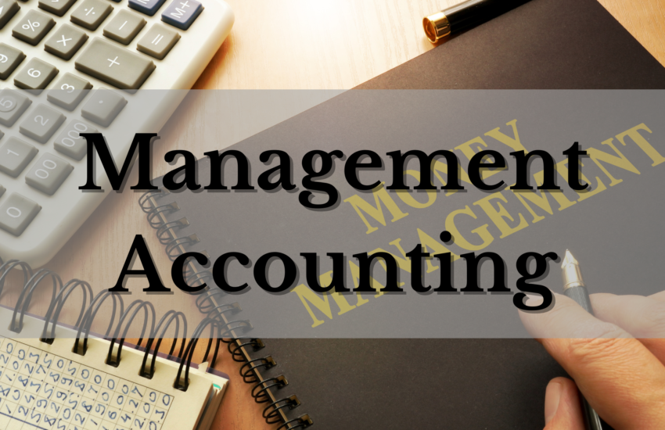
Management Accounting
Management accounting is the combination of ‘Financial Accounting’ and ‘Cost Accounting’.
It is that part of accounting which is concerned with internal reporting to the top management.
It relates to planning, control and decision making.

Slide 67
Social Responsibility Accounting
The days are away when business organization had objective of only profit earning.
The enterprise has not only to prove its utilization of funds for earning profit, but also has to work towards the well being of the society.
The Government of India has made it mandatory to make CSR (Corporate Social Responsibility Voluntary Disclosure) from 21st December 2009.
According to guidelines, business should cover some core elements, such as: Care for all stake holders, Ethical functioning, Respect to workers’ right and welfare, Respect for human rights, Respect for environment, Activities for social and inclusive development.

Slide 68

Human Resource Accounting
The human resources are vital for any enterprise having large number of employees.
The long term planning of qualitative human resource variables results in greater benefits in the long run.
An accountant always views assets (including human assets) as something with a value on the balance sheet as yet; Human Resource value does not appear as an ‘Asset’.
The cost of HR encompasses: Cost of recruiting, Cost of selection, Cost of contracting, Cost of placing, Cost of training, Cost of orientation, Cost of promotion, Cost of improvement, Cost of substitution, Opportunity cost, Exit cost, Etc.

Slide 69

Environmental Accounting
Responsibility towards environment has become one of the most crucial areas of social responsibility.
The era is alarming the global warming due to deforestation, pollution of air, water and sound. And it has tremendously affected the environment, not only its nearby areas but, of city, the country and nation at large.
A tradeoff between environmental protection and development is required.

Slide 70
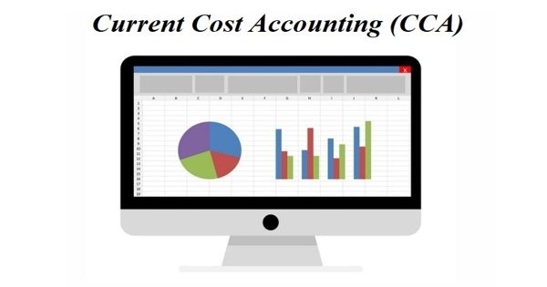
Current Cost Accounting
Current cost accounting attempts to provide more realistic approach of financial position of an enterprise by valuing assets at current replacement cost, rather than historical cost (the amount actually paid for them).
The problems that current cost accounting attempts to solve are obviously linked to inflation.

Slide 71
Accounting Concepts and Accounting Conventions

Slide 72
Concepts of Accounting
The term accounting concepts refer to basic rules, assumptions, and principles which act as a primary standard for recording business transactions and maintaining books of accounts.
Money Measurement Concept
The Going Concern Concept
The Business Entity Concept
The Realization Concept
Accrual / Matching Concept
Historical Cost Concept
Periodicity Concept
Dual Aspect Concept
72

Slide 73

Money Measurement Concept
All business transactions are expressed, recorded and measured only in terms of money.
Monetary Unit – money is the common denominator.
In India, Rupee is the unit.
E.g., Accounting doesn’t tell how good the quality of employees’ skills are although this is important for the success of the business.

Slide 74

The Going Concern Concept
This concept implies that the business will continue to operate for the foreseeable future.
Going Concern – company to last long enough to fulfill objectives and commitments.
It is like continuous process, even if the founder of the business dies, business doesn’t stop.

Slide 75
Business Entity Concept
Business is distinct from the owners.
This concept implies that the affairs of a business are to be treated as being quite separate from the non-business activities of its owners.
Personal transactions of the owner should not be included.
Economic Entity – Company keeps its activity separate from its owners and other businesses.
Accounting record takes note of the dealing between business and owners just like outsiders. (Drawing and Capital)
E.g., A Director’s private car should not be included in the fixed assets of the company.

Slide 76
Realization Concept
This concepts holds to the view that profit can only be taken into account when realization has occurred.
Generally, sales revenue arising from the sale of goods are recognized when the goods are delivered to the customers.
Only order of goods is not done, we can make record only when goods are supplied.
E.g., Profit is earned when goods or services are provided to customers. Thus, it is incorrect to record profit when order is received, or when the customer pays for the goods.
E.g., Bad debts - when money is received from the debtors at that time only we remove it.

Slide 77
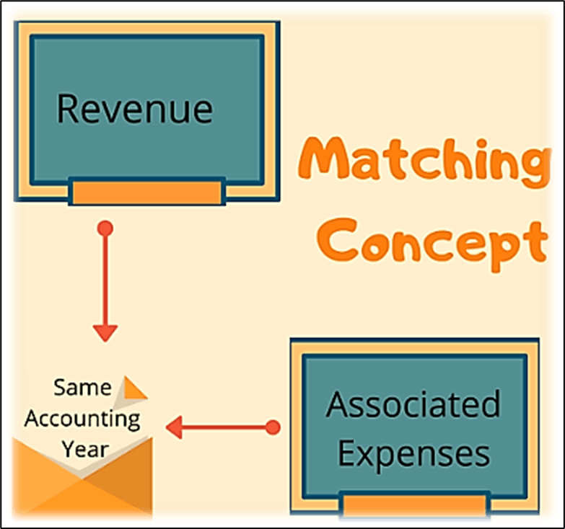
Matching Concept
This concept says that net profit is the difference between revenues and expenses.
The revenues and relevant expenses incurred should be correlated and matched.
Revenues = expenses

Slide 78

Historical Cost Concept
All transactions and events are recorded at their monetary cost of acquisition.
Assets are normally shown at their original costs.
Any changes in the market value after the purchase are ignored.
E.g., A fixed asset acquired at a cost of Rs. 1,00,000 would be recorded at this amount in the books. Even if its market value may have gone up or down in the future, it should be recorded at its original cost of Rs. 1,00,000.

Slide 79
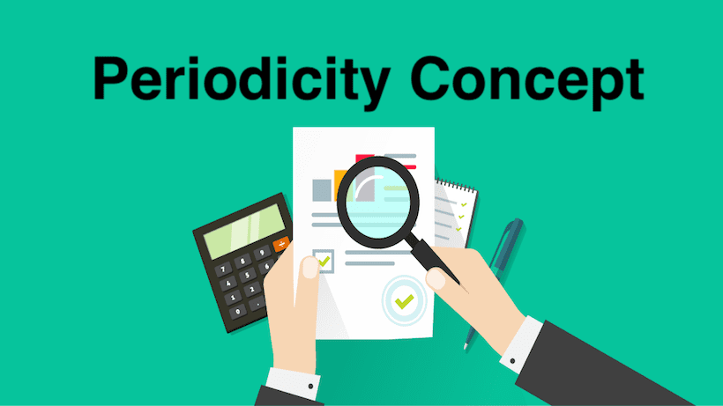
Periodicity/Time Period Concept
Business must be done at periodic intervals during the lifetime of the business enterprise.
PERIODICITY – Company can divide its economic activities into time periods.
Normal accounting period is 12 months.
E.g., Calendar Year – From 1st January to 31St December
E.g., Financial Year – From 1st April to 31St March

Slide 80
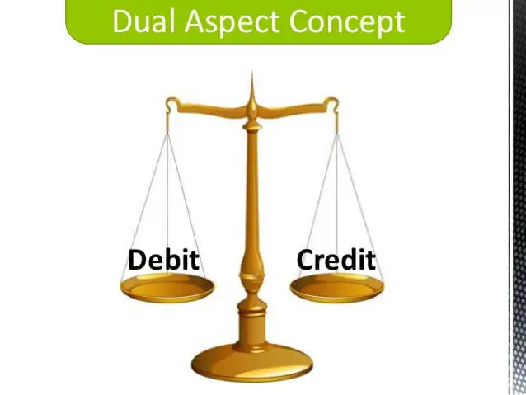
Dual Aspect Concept
Every transaction has two effects: Debit and credit.
Accounting equation : A = C + L
Assets are equal to Capital & Liabilities.
E.g., Goods Purchase of ₹3,00,000 one effect goods Purchase and another effect is Cash balance reduce.

Slide 81
Conventions of Accounting
Accounting conventions are guidelines used to help companies determine how to record certain business transactions that have not yet been fully addressed by accounting standards.
Materiality
Prudence/Conservatism
Consistency
Disclosure
81

Slide 82
Materiality
An item is material, if its inclusion or omission would influence or change the judgment of a reasonable person.
New lead pencil is an asset, but its not needed to record. (Depreciation on Pencil)
In other words, do not waste your time in the elaborate recording of trivial items.
E.g., a stock of stationary worth Rs. 10 should be treated as an expense, when it was bought.
E.g., Miscellaneous expense

Slide 83
Prudence/Conservatism
The accountant should always be on the side of safety.
Consider all probable losses but not taking credit for favorable event, unless it takes place.
“Anticipate no profit & provide for all conceivable losses.”
E.g., Provision for doubtful debts (BDR) should be deducted from debtors in balance sheet.
E.g., Closing stock – lower value is taken into consideration.

Slide 84
Consistency
Accounting policies must be consistent from year to year.
Same policies, procedures and methods are followed continuously.
Frequent changes in the accounting methods would lead to misleading profits calculated from the accounting records.
E.g., Depreciation method of certain fixed assets once adopted should be used in the following years.
E.g., FIFO Method – 1st year & LIFO Method – 2nd year

Slide 85
Disclosure
The financial statements of a firm must include all information necessary for the formation of valid decisions by the users.
Any information that might be relevant to an investor or creditor should be disclosed, either in body of the financial statements or in the notes attached thereto.
E.g., BEING, in journals
E.g., Notes or Contingent liabilities

Slide 86
CW – 1 Classify the given accounts

Slide 87
Classification of Accounts
Capital A/c
Drawings A/c
Building A/c
Carriage Inward A/c
Cash Received A/c
Interest Paid A/c
Commission Received A/c
Furniture A/c

Slide 88
Classification of Accounts
Bank A/c
Discount Allowed A/c
Sales Promotion A/c
Bad-Debts Written-off A/c
Stationery Bought A/c
Outstanding Salary A/c
Wages & Salaries A/c
Prepaid Rent A/c

Slide 89
Classification of Accounts
Bad-Debts Recovered A/c
Borrowed Loan A/c
Interest Received in Advance
Stationery Expense A/c
Travelling Charges A/c
Bank Overdraft A/c
Stock of Goods A/c
Subscription Received A/c

Slide 90
Classification of Accounts
Copyright A/c
Dena Bank A/c
Telephone Expense A/c
Raja Babu’s A/c
Repairing Charges A/c
Dharma Production’s A/c
Conveyance Charges A/c
Adani Power Ltd. a/c

Slide 91
Classification of Accounts
Capital A/c - P
Drawings A/c - P
Building A/c - R
Carriage Inward A/c - N
Cash Received A/c - R
Interest Paid A/c - N
Commission Received A/c - N
Furniture A/c - R

Slide 92
Classification of Accounts
Bank A/c - P
Discount Allowed A/c - N
Sales Promotion A/c - N
Bad-Debts Written-off A/c - N
Stationery Bought A/c - R
Outstanding Salary A/c - P
Wages & Salaries A/c - N
Prepaid Rent A/c - P

Slide 93
Classification of Accounts
Bad-Debts Recovered A/c - N
Borrowed Loan A/c - P
Interest Received in Advance - P
Stationery Expense A/c - N
Travelling Charges A/c - N
Bank Overdraft A/c - P
Stock of Goods A/c - R
Subscription Received A/c - N

Slide 94
Classification of Accounts
Copyright A/c - R
Dena Bank A/c - P
Telephone Expense A/c - N
Raja Babu’s A/c - P
Repairing Charges A/c - N
Dharma Production’s A/c - P
Conveyance Charges A/c - N
Adani Power Ltd. a/c - P

